Slide 1
12 Factor App
Pravin Y Pawar

Slide 2
Need
Developers are moving apps to the cloud, and in doing so, they become more experienced at designing and deploying cloud-native apps!
From that experience, a set of best practices, commonly known as the twelve factors, has emerged
Designing an app with these factors in mind
lets you deploy apps to the cloud that are more portable and resilient
when compared to apps deployed to on-premises environments where it takes longer to provision new resources
Designing modern, cloud-native apps requires a change in how you think about
software engineering
configuration
and deployment
when compared to designing apps for on-premises environments

Slide 3
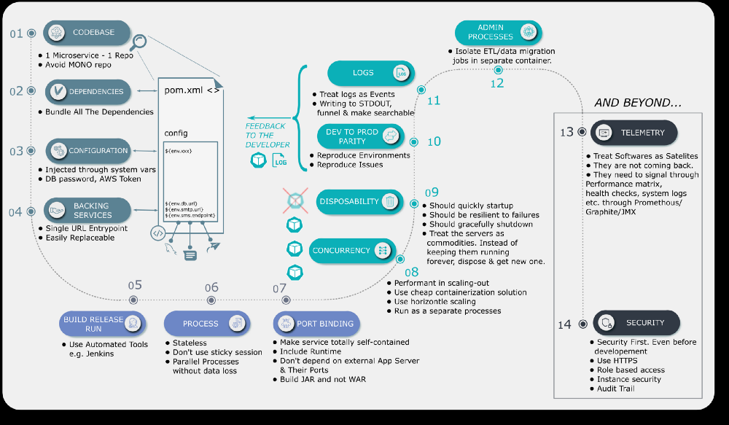
12 factors and beyond
source

Slide 4
Thank You!
In our next session:

